Slide 1

AI Readiness Scale (AIRS)
Development and Validation of a Psychometric Instrument for Assessing Enterprise AI Adoption
DOCTOR OF BUSINESS ADMINISTRATION
N = 523 · OCTOBER–NOVEMBER 2025

Slide 2
The Adoption-Value Gap
88%
5%
90–95%
AI Tool Usage
Value Realized
Pilots Stall
Among knowledge workers in 2025, up from 50% in 2023
Organizations reporting measurable value from AI implementations
Generative AI pilot programs that never progress beyond initial trials
Organizations invest heavily in AI tools but consistently fail to realize meaningful returns. This adoption-value gap — not a lack of tools, but a failure to convert adoption into value — is the central problem this research addresses.

Slide 3

Three Interconnected Research Gaps
Theoretical Gap
UTAUT2 was validated for consumer mobile technologies. Whether its predictor structure holds for AI — characterized by autonomous decision-making and probabilistic outputs — remained empirically untested.
Measurement Gap
No validated psychometric instrument existed for measuring AI-specific adoption readiness. Existing scales addressed general technology acceptance or narrow AI applications like healthcare robotics.
Practice Gap
Organizations lacked evidence-based frameworks to identify specific barriers and design targeted interventions, leaving AI implementation strategies generic rather than responsive to each workforce's readiness profile.

Slide 4
Research Solution: The AIRS Instrument
What Was Built
What It Addresses
The AI Readiness Scale (AIRS) — a 16-item psychometric instrument extending UTAUT2 with an AI Trust construct.
Provides a theoretical account of AI adoption drivers
Offers a practical diagnostic tool for organizational assessment
Enables targeted, evidence-based intervention design
Fills all three identified research gaps simultaneously
8 factors × 2 items each, plus 4 Behavioral Intention outcome items.

Slide 5
Theoretical Foundation: UTAUT2
The study built upon UTAUT2 — the most comprehensive and widely validated model of technology acceptance — which integrates seven constructs predicting Behavioral Intention to use a technology.
PE
EE
SI
Performance Expectancy: Perceived improvement in job performance
Effort Expectancy: Perceived ease of learning and use
Social Influence: Degree to which important others encourage use
FC
HM
PV
Facilitating Conditions: Available resources and support
Hedonic Motivation: Pleasure derived from use
Price Value: Perceived cost-benefit balance
HB
Habit: Extent to which use has become automatic

Slide 6
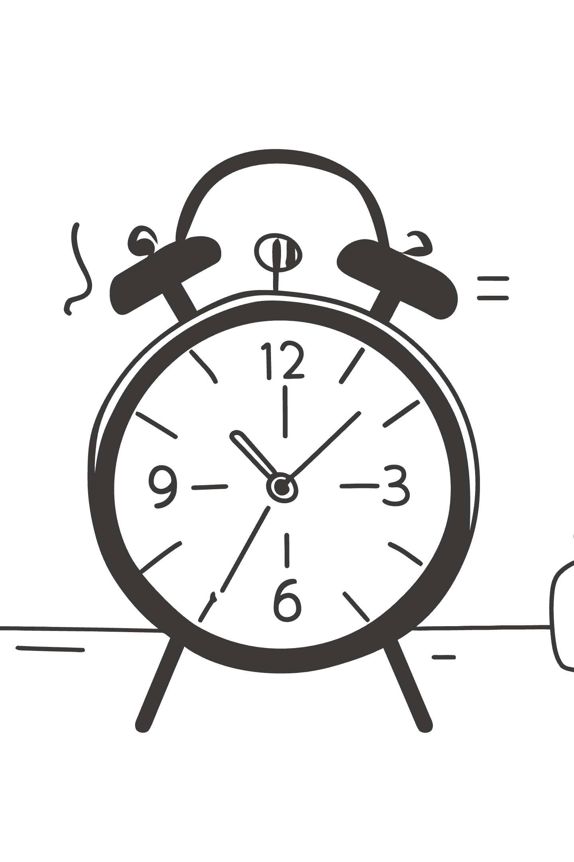
The 8th Construct: AI Trust
AI tools differ from conventional technologies in their capacity for autonomous reasoning, opaque decision processes, and evolving behaviors.
The study introduced AI Trust (TR) as an eighth construct — capturing the degree to which users believe AI systems will provide accurate, reliable information and operate in a trustworthy manner.
This extension was grounded in emerging literature identifying trust as a unique barrier to AI adoption not adequately captured by existing UTAUT2 constructs.

Slide 7
Research Questions & Hypotheses
Primary Research Question
12 Hypotheses Tested
To what extent does UTAUT2, extended with AI Trust, explain Behavioral Intention to adopt AI tools among U.S. students and professionals?
H1a–H1g
H2
7 core UTAUT2 path hypotheses
AI Trust hypothesis
Secondary RQs
RQ2: Factorial validity and psychometric adequacy
RQ3: Experience and role moderation of structural paths
RQ4: Relationship between behavioral intention and actual usage
RQ5: User typology based on readiness patterns
H3–H4
H5–H6
2 moderation hypotheses
2 behavioral validation hypotheses

Slide 8


Methodology: Research Design
Quantitative
Psychometric
Qualitative
Triangulation
A post-positivist, sequential mixed-methods design with quantitative primacy. The quantitative phase provided the primary evidence base; the qualitative phase offered contextual elaboration and triangulation.

Slide 9
Instrument Development Process
Exploratory Factor Analysis
Initial Item Pool
Four competing factor models (A–D) evaluated on the development subsample. Model D — the 8-factor, 16-item solution — selected for optimal structure, reliability, and theoretical interpretability.
28 items across 12 constructs, adapted from validated UTAUT2 scales and supplemented with AI-specific items for Trust, Explainability, Ethical Risk, and AI Anxiety.
Final Instrument
Construct Exclusion
8 factors × 2 items each = 16 items, plus 4 Behavioral Intention items as the outcome variable.
Four constructs dropped due to inadequate reliability: Voluntariness (α = .41), Explainability (α = .58), Ethical Risk (α = .55), AI Anxiety (α = .30).

Slide 10

Sample & Data Collection
Sample Overview
Role Distribution
N = 523 U.S. adults recruited via Centiment using topic-blinded recruitment — respondents did not know the survey concerned AI, mitigating self-selection bias.
41%
35%
Academic
Professional
Collection Period: October–November 2025 (3-week window)
Students (n = 216)
Individual contributors, freelancers (n = 184)
24%
Leader
Managers, executives (n = 123)
68 participants (13.0%) reported a disability — a proportion consistent with U.S. Census Bureau estimates and sufficient for exploratory between-group analysis.

Slide 11
10-Phase Analytical Pipeline
Phase 0–1
1
Sample splitting (50/50, stratified) + EFA on development sample (n = 261)
2
Phase 2–3
CFA on holdout sample (n = 262) + Measurement invariance testing
Phase 4–6
3
Structural Equation Modeling + Mediation analysis + Moderation analysis
4
Phase 7–8
Behavioral validation (tool usage) + Qualitative content analysis
Phase 9–10
5
Comprehensive review and synthesis across dual platforms (Python + R/lavaan)
Bootstrap validation used 1,000 resamples for path coefficient robustness. CFA/SEM used Maximum Likelihood with Satorra-Bentler robust corrections (MLM) via R/lavaan 0.6.21.

Slide 12
KEY FINDINGS
Measurement Model: Psychometric Performance
The 16-item data demonstrated excellent suitability for factor analysis: KMO = .937 (superb), Bartlett's Test χ² = 4,668.45, p < .001, with no multivariate outliers detected.
Index
Holdout Value
Full Sample
Threshold
Assessment
CFI
.975
.979
≥ .95
Excellent
TLI
.960
.966
≥ .95
Excellent
RMSEA
.065
.061
≤ .08
Good
SRMR
.026
.022
≤ .08
Excellent
χ²/df
2.10
—
≤ 3.0
Good

Slide 13
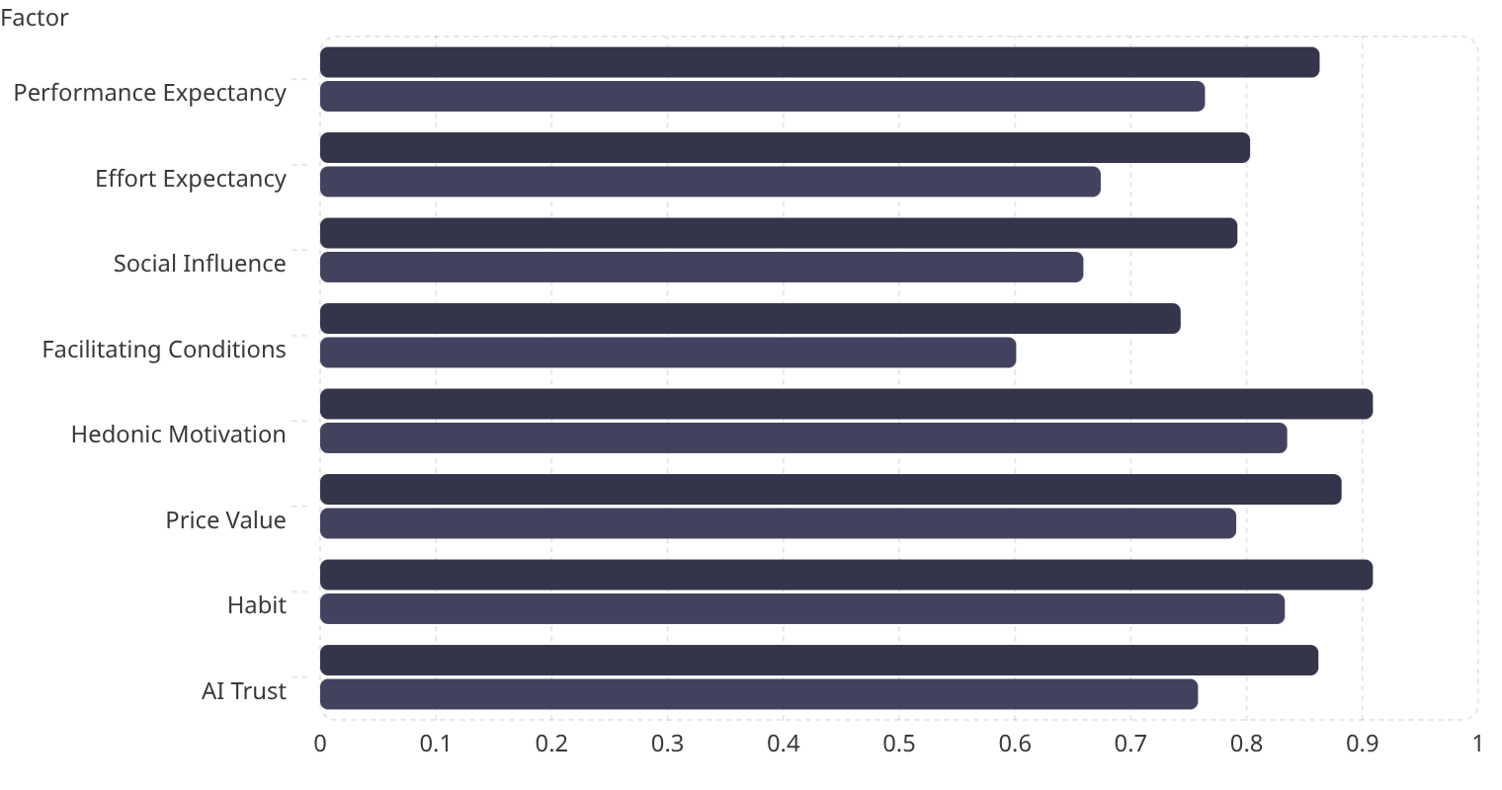
Reliability Across All 8 Factors
All eight factors exceeded conventional thresholds for internal consistency. All composite reliabilities exceeded .750 and all AVE values exceeded .50, confirming convergent validity.
Cronbach's α
AVE

Slide 14
Discriminant Validity: HTMT Analysis
Factor Correlation Range
Interpretation
r = .516 (EE × SI) to r = .911 (PE × PV)
Violations are structurally expected for 2-item-per-factor scales with conceptually adjacent constructs in the PE–HM–PV triad.
HTMT Violations (4 pairs)
The CFA model demonstrated excellent overall fit. The retained 8-factor structure provides essential diagnostic differentiation — each construct measures a distinct intervention target.
Pair
HTMT
Status
PE × PV
.902
Exceeds
PE × HM
.900
Exceeds
HM × PV
.904
Exceeds
HM × TR
.850
At threshold

Slide 15
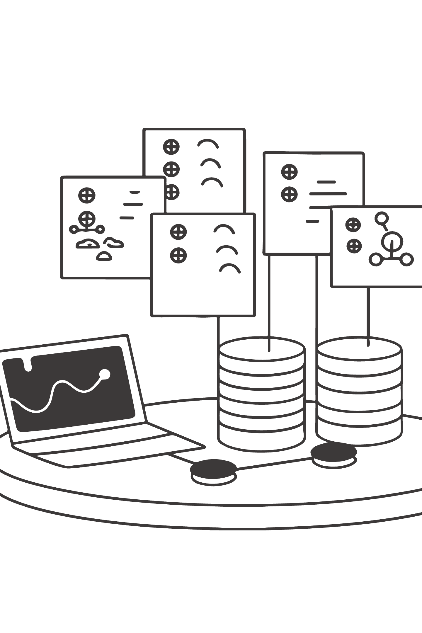
CENTRAL FINDING
Structural Model: 89.7% Variance Explained
The structural model explained R² = .897 of the variance in Behavioral Intention — an exceptionally high value indicating that the AIRS factors capture the vast majority of systematic variance in AI adoption intention.

Slide 16
Primary Path Coefficients
H
Path
β
p
Bootstrap 95% CI
Result
H1a
PE → BI
−.028
.791
[−.234, .178]
Not Supported
H1b
EE → BI
−.008
.875
[−.108, .092]
Not Supported
H1c
SI → BI
.136
.024
[.018, .254]
Supported*
H1d
FC → BI
.059
.338
[−.062, .180]
Not Supported
H1e
HM → BI
.217
.014
[.044, .390]
Supported*
H1f
PV → BI
.505
<.001
[.352, .658]
Confirmed — Strongest
H1g
HB → BI
.023
.631
[−.071, .117]
Not Supported
H2
TR → BI
.106
.064
[−.006, .218]
Marginal
*z-test significant; bootstrap CIs include zero — interpreted as suggestive rather than conclusive. Only Price Value's path was bootstrap-confirmed robust (CI [0.218, 1.083]).

Slide 17

BREAKTHROUGH FINDING
Price Value Dominates — A Paradigm Shift
Prior UTAUT Literature
Present Study
Blut et al. (2022) meta-analysis across 417+ studies: Performance Expectancy was the dominant predictor (weighted β = .39)
PE was non-significant (β = −.028), while Price Value dominated (β = .505)
Interpretation: When users already regard AI's usefulness as a baseline expectation, adoption decisions shift to whether perceived benefits justify the financial investment.

Slide 18
AI Trust: Why It Was Retained
Although AI Trust did not reach conventional significance (p = .064) and model comparison favored the 7-factor model on parsimony grounds (ΔAIC = +2.01), the 8-factor model was retained as the recommended diagnostic instrument for three reasons:
1
2
3
Unique Diagnostic Capability
Statistical Power Limitation
Actionable Intervention Target
Trust deficits cannot be detected by other constructs — organizations need this signal separately.
Detecting the marginal effect (β = .106) at 80% power requires n > 600; the present N = 523 yields only ~68% power.
Organizations gain actionable insight from separately measuring trust, enabling targeted confidence-building interventions.

Slide 19
Moderation Effects
Experience Moderation (H3: Partially Supported)
Population Moderation (H4: Partially Supported)
Professional experience significantly moderated the HM → BI path (β = .136, p = .007). Professionals with 4+ years weighted hedonic motivation more heavily.
Hedonic Motivation showed significant population moderation (p = .041):
Academic group: HM β = 0.449 (strong positive)
Professional group: HM β = −0.301 (negative)
Usage-Group Comparison
Academics adopt AI partly for the enjoyment of exploration; professionals may view "enjoyment" as irrelevant to task-focused work. Price Value remained dominant for both groups.
Low-usage group: Performance Expectancy mattered (β = .371, significant)
High-usage group: Price Value dominated (β = .878, significant)
Adoption drivers evolve with experience: new users focus on utility; experienced users focus on value.

Slide 20
Behavioral Validation
ρ=.69
ρ=.57
ρ=.54
ρ=.52
BI → Usage
ChatGPT
MS Copilot
Google Gemini
Behavioral Intention strongly associated with actual AI tool usage frequency (p < .001)
Individual tool correlation with Behavioral Intention
Individual tool correlation with Behavioral Intention
Individual tool correlation with Behavioral Intention
Role differences confirmed a clear hierarchy — Leaders > Professionals > Academics — across tool breadth (F = 18.42, η² = .066), usage frequency (F = 22.15, η² = .078), and usage intensity (F = 15.87, η² = .058). Leaders showed particularly elevated Microsoft Copilot usage (Cohen's d = 1.14 vs. Professionals), reflecting enterprise licensing.

Slide 21

Three-Segment User Typology
🚀 AI Enthusiasts
⚖️ Moderate Users
31% (n = 162)
47% (n = 246)
Early adopters with high engagement across all dimensions. Mean BI = 4.23.
Pragmatic users near population means.
Role: Provide value demonstrations and social proof from peers.
Role: Deploy as change champions and peer influencers.
🛑 AI Skeptics
22% (n = 115)
Resistant users with below-mean readiness scores. Mean BI = 1.71.
Role: Address trust barriers and anxiety before engagement strategies.
K-means cluster analysis (k = 3, silhouette = 0.271) explained 65.9% of BI variance (F(2, 520) = 503.47, p < .001, η² = .659), confirming a clear readiness gradient.

Slide 22
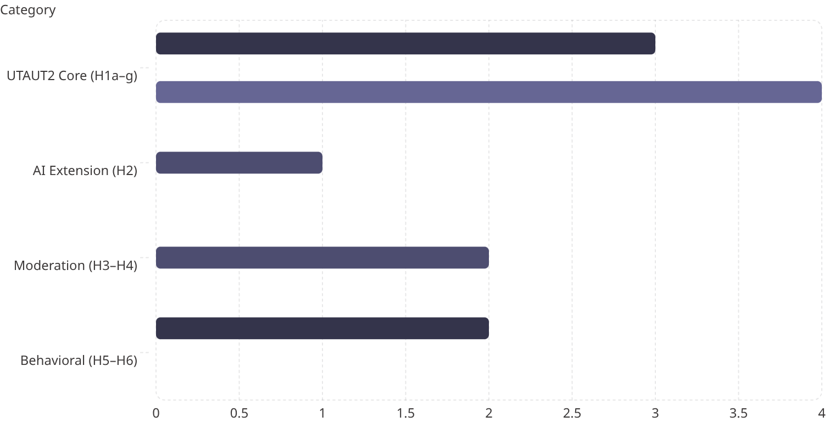
Hypothesis Outcome Summary
Supported
Partial/Marginal
Not Supported
Of 12 hypotheses: 5 supported (42%), 3 partial (25%), 4 not supported (33%). The pattern reveals that AI adoption follows a different predictor structure than traditional technology adoption — cost-value perceptions displace utility perceptions as the primary driver.

Slide 23
Qualitative Themes
Open-ended responses (n = 243, 46.5% response rate) revealed five dominant themes:
Positive Experience
Work & Productivity
Human Element
24.7% — Most prevalent theme; users describing satisfying AI interactions
19.3% — Efficiency gains and task completion as primary value drivers
13.6% — Concerns about human judgment and AI's role in decision-making
Learning & Education
Accuracy & Reliability
13.6% — Academics emphasized educational applications prominently
10.7% — Trust-related concerns about AI output quality

Slide 24
THEORETICAL CONTRIBUTIONS
Six Contributions to Knowledge
01
02
Empirical Extension of UTAUT2 for AI
Price Value Dominance — AI as Distinct Category
First study to empirically validate UTAUT2 for AI tool adoption with a purpose-built psychometric instrument.
Challenges decades of UTAUT research positioning PE as primary driver; utility functions as a baseline expectation in AI contexts.
03
04
Career Development Integration
Three-Segment User Typology
Adoption mechanisms are career-stage dependent — same technology produces fundamentally different dynamics in academic vs. professional contexts.
Empirically derived segmentation framework explaining 65.9% of BI variance — grounded in validated psychometric dimensions.
05
06
Converging 2025 Industry Validation
Adoption-Value Gap Mechanisms
McKinsey (N = 1,993), BCG, MIT, Gartner, Deloitte, and others independently reported patterns consistent with AIRS findings.
Four specific mechanisms identified: value communication misalignment, heterogeneous readiness, neglected affective barriers, and context-inappropriate frameworks.

Slide 25

PRACTICAL IMPLICATIONS
For Organizations Deploying AI

Slide 26
Lead With Value, Not Capability
Because Price Value is the strongest predictor of adoption intention (β = .505), organizations should communicate AI investments in terms of tangible cost-benefit outcomes: time saved, errors reduced, and revenue generated.
Change initiatives centered primarily on technical capability claims are likely to be less effective than those that demonstrate concrete financial and productivity returns.
Less Effective
More Effective
"Our AI can do X, Y, and Z tasks autonomously."
"Our AI saves 3 hours/week per employee and reduces error rates by 40%."

Slide 27



Segmented Rollout Strategy
The three-segment typology supports targeted intervention rather than uniform deployment. A single strategy will fail for at least one-third of the workforce.
Enthusiasts (31%)
Moderate Users (47%)
Skeptics (22%)
Deploy as change champions and peer influencers. Provide access to advanced capabilities and mentorship structures.
Provide value demonstrations and social proof from peers. Structured skill development and ROI evidence move this group.
Address trust barriers and anxiety first. Generic training will not move this group — graduated exposure and evidence-based demonstrations are required.

Slide 28
8 Structured Practitioner Recommendations
1
Diagnose before prescribing
Conduct baseline AIRS assessment before designing AI adoption initiatives.
2
Lead with value
Frame AI in terms of cost-benefit returns (PV dominance), not capability showcases.
3
Attend to affective barriers
Hedonic motivation and anxiety influence adoption beyond rational calculations.
4
Leverage social influence
Peer champions and leadership endorsement are the third significant predictor (SI β = .136).
5
Differentiate by experience level
Novice and experienced users respond to different adoption drivers.
6
Monitor trust continuously
Trust functions as a diagnostic indicator and necessary condition, not just a predictor.
7
Design for accessibility
Universal design principles reduce anxiety-driven non-adoption among users with disabilities.
8
Consider segment heterogeneity
Any single intervention strategy will fail for at least one-third of the workforce.

Slide 29
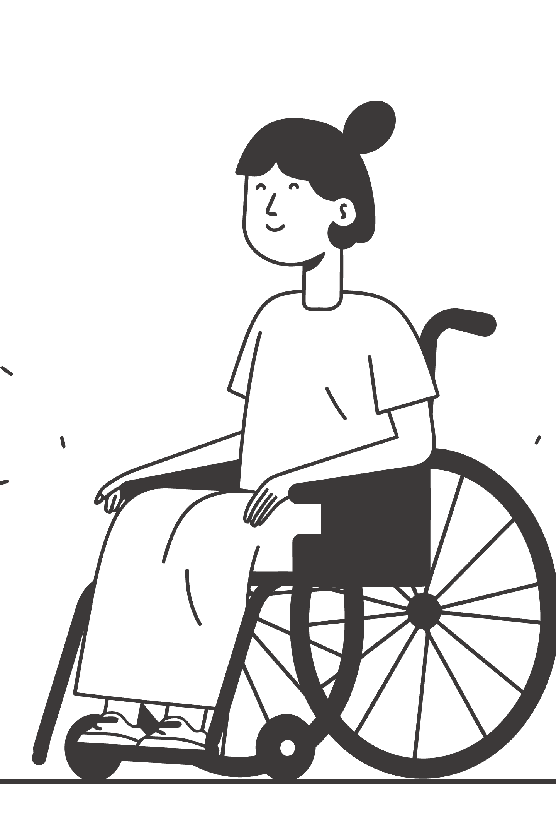
SPECIAL SECTION
Neurodiversity & Disability Insights
68 participants (13.0%) self-reported a disability — sufficient for exploratory between-group analysis. These findings are among the most practically salient results in the dissertation.

Slide 30
The Core Disability Finding
AI Anxiety Gap
Broader Pattern Across Constructs
Participants with disabilities reported significantly higher AI-related anxiety:
Two findings reached significance:
AI Anxiety: d = .36, p = .006
Hedonic Motivation: d = .28, p = .030 — participants with disabilities report significantly less enjoyment from AI tools
M = 2.89 (SD = 1.08) vs. M = 2.48 (SD = 0.96)
t(521) = 2.76, p = .006, Cohen's d = 0.36
Notably, this finding emerged from AI Anxiety items that were subsequently excluded from the final AIRS-16 — suggesting the true effect may be larger than observed.
The remaining six constructs show consistent directional differences (d = 0.12–0.24) all favoring the non-disabled group — a coherent disadvantage profile, not random noise.

Slide 31
Disability: Design Problem, Not User Problem
Anxiety Reflects Lived Experience
HM Suppression Signals Design Failure
For users who have repeatedly encountered inaccessible interfaces or algorithmic bias, elevated anxiety about AI is a rational response to historical exclusion — not a deficit to be corrected.
The significant HM gap (d = .28) implies current AI tools are less enjoyable for users with disabilities — pointing to accessibility failures, not user limitations.
The Curb Cut Effect
AIRS-28 Priority
Making AI tools more accessible would reduce anxiety-driven non-adoption broadly. If the disability–anxiety association reflects design-induced friction, removing that friction benefits the entire user population.
AI Anxiety — the construct with the strongest disability signal — was excluded from the final scale. The AIRS-28 expansion should prioritize redesigning anxiety items using neurodiversity-informed language.

Slide 32
Study Limitations
Methodological
Measurement
Cross-sectional design — prevents causal inference about direction of relationships or how adoption intentions evolve over time
Self-reported intention — BI-Usage correlation (ρ = .69) confirms association, but intention does not perfectly predict behavior
Panel sampling — Centiment panel may not perfectly represent the broader U.S. population
Western sample — all U.S.-based, limiting cross-cultural generalizability
Two items per factor — constrains reliability and contributes to elevated inter-factor correlations
Four dropped constructs — Voluntariness, Explainability, Ethical Risk, and AI Anxiety warrant item redesign and re-investigation
Marginal AI Trust — did not reach conventional significance; diagnostic value supported by organizational logic rather than predictive superiority
Small disability subgroup (n = 68) — limits power for multi-category disability analysis

Slide 33




FUTURE RESEARCH
Four-Phase Research Roadmap
Phase 1 (2026–27)
Phase 2 (2026–28)
AIRS-28 Development: Expand to 3–4 items per factor; redesign Explainability, Ethical Risk, and AI Anxiety items
Longitudinal Panel + Cross-Cultural Validation: 12-month panel tracking readiness evolution; validate across non-Western contexts
Phase 3 (2028–29)
Phase 4 (2029+)
Intervention Framework Development: Design and test AIRS-informed interventions; compare against generic AI training approaches
Comprehensive Prediction System: Integrate AIRS with behavioral data, organizational context, and industry-specific moderators

Slide 34
Appropriate Reliance: The Next Frontier
The goal should not be maximum adoption but appropriate adoption — knowing when to use AI and when to rely on human judgment.
The AETHER group's Calibrated AI Reliance (CAIR) and Calibrated Self-Reliance (CSR) constructs reframe the research program from "more adoption is better" to "calibrated adoption is optimal." This evolution addresses the paradox that optimizing AI adoption may inadvertently increase over-reliance.
This line of inquiry is extended in The Life of Alex Finch (AlexBooks, March 2026), a documentary biography of human-AI collaboration whose "Calibrated Confidence" chapter addresses over-reliance, verification, and preservation of human judgment in a public-facing narrative form.

Slide 35
2026 Contextual Developments
The AI landscape has shifted materially since data collection (October–November 2025). Three developments frame the ongoing research agenda:
DeepSeek R1 Release
Agentic AI Systems
EU AI Act Enforcement
Open-source frontier AI capabilities are no longer exclusive to well-resourced organizations — fundamentally changing the Price Value calculation for all users.
AI operating with greater autonomy raises new trust and control questions beyond the original AIRS scope — expanding the required construct space.
Regulatory compliance emerges as a new adoption consideration absent from the current UTAUT2 framework — requiring future model expansion.
These developments do not invalidate the AIRS findings but indicate that the construct space will need to expand to remain comprehensive.

Slide 36
The AIRS-16 Final Instrument
The AI Readiness Scale consists of 16 predictor items across 8 constructs plus 4 Behavioral Intention outcome items, measured on a 5-point Likert scale (1 = Strongly Disagree to 5 = Strongly Agree).
Construct
Item
Statement
Item
Statement
PE
PE1
AI tools help me accomplish tasks more quickly.
PE2
Using AI improves the quality of my work or studies.
EE
EE1
Learning to use AI tools is easy for me.
EE2
Interacting with AI tools is clear and understandable.
SI
SI1
People whose opinions I value encourage me to use AI tools.
SI2
Leaders in my organization or school support the use of AI tools.
FC
FC1
I have access to training or tutorials for the AI tools I use.
FC2
The AI tools I use are compatible with other tools or systems I use.
HM
HM1
Using AI tools is stimulating and engaging.
HM2
AI tools make my work or studies more interesting.
PV
PV1
I get more value from AI tools than the effort they require.
PV2
Using AI tools is worth the learning curve.
HB
HB1
Using AI tools has become a habit for me.
HB2
I tend to rely on AI tools by default when I need help with tasks.
TR
TR1
I trust AI tools to provide reliable information.
TR2
I trust the AI tools that are available to me.

Slide 37

AIRS Scoring & Diagnostic Use
Compute the mean of each construct's items. The 8 predictor scores serve as inputs to the structural model; BI is the outcome.
Low PV Score
Low TR Score
Value communication gap — organization is not demonstrating tangible ROI from AI investments
Trust deficit — requires explainability tools, human-in-the-loop safeguards, and transparent error reporting
Low SI Score
Low HM Score
Insufficient peer/leadership advocacy — requires champion programs and endorsement campaigns
Engagement deficit — requires gamification, AI sandboxes, and social learning communities
For organizational diagnostic use, individual construct scores identify specific adoption barriers and map directly to evidence-based intervention strategies.

Slide 38
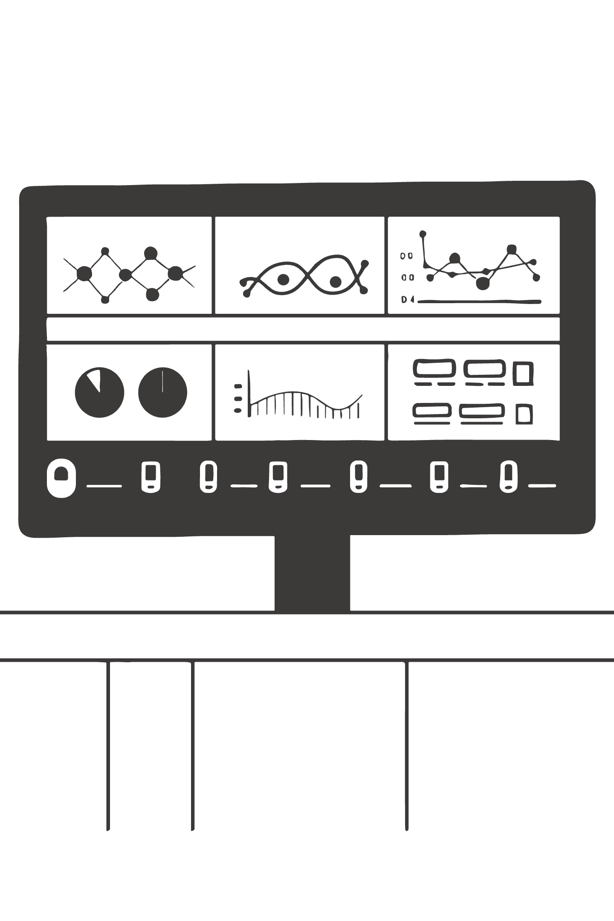
APPENDIX B
AIRS Enterprise: Research to Practice
The AIRS Enterprise platform (airs.correax.com) translates the validated AIRS-16 into a production SaaS platform — delivering practical assessment tools, enabling longitudinal data collection at scale, and narrowing the research-practice gap.

Slide 39
Platform Core Capabilities
5-Minute Assessment
AIRS Score
Interactive AIRS-16 with progress tracking, save/resume, and smart follow-up questions
Composite readiness score (8–40) with demonstrated validity (r = .876) and animated gauge visualization
Typology Classification
AI-Personalized Guides
Three-segment classification at 94.5% accuracy matching the empirically derived clusters
Streaming LLM-generated action plans (3–5 pages) tailored to individual profile and career context via Azure OpenAI GPT-4o-mini
Results Visualization
Organization Management
8-axis construct radar chart and typology badge with actionable context in 29 languages
Team analytics, department/role segmentation, CSV exports, impact reporting, and longitudinal tracking

Slide 40
Three Intervention Frameworks
🔄 TRANSFORM
🔧 REDESIGN
⚡ AMPLIFY
Skeptics (AIRS ≤ 20)
Moderate Users (AIRS 21–30)
Enthusiasts (AIRS > 30)
Trust-building through graduated autonomy — starting with low-risk AI tasks, demonstrating reliability through small wins, progressively expanding scope. Emphasizes explainability and human-in-the-loop safeguards.
Workflow integration and ROI demonstration — identifying specific processes where AI adds measurable value, providing social proof through peer success stories, building competence through structured skill development.
Champion network activation — leveraging high-readiness individuals as change agents, providing access to advanced AI capabilities, creating mentorship structures that accelerate adoption across the organization.

Slide 41
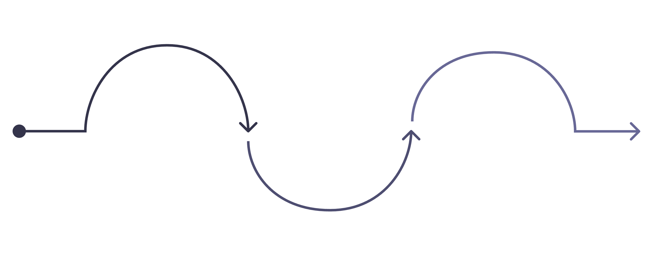
Organizational Engagement Model
Baseline Assessment
Implementation
Intervention Design
Ongoing: adoption metrics, reassessment, barriers
Weeks 1-2: AIRS-16 & typology mapping
Weeks 3-6: segment protocols & 90-day plan
Every organizational deployment generates structured data (8 construct scores, composite AIRS score, typology classification, demographic context) that feeds directly into the normative benchmarking database.

Slide 42
Longitudinal Validation Program
T1 — Baseline
Initial AIRS-16 administration; establish individual and organizational readiness profiles
T2 — 3 Months
Score stability assessment; early intervention responsiveness measurement
T3 — 6 Months
Mid-point predictive validity check; typology migration tracking
T4 — 12 Months
Full longitudinal validation; normative benchmarking across 8+ target groups (N = 300–500+ each)
Target groups for normative benchmarking (2026–2028): students, early/mid/senior career professionals, technology sector, healthcare, finance, and international samples.

Slide 43

The Research-Practice Bridge
AIRS Enterprise represents a deliberate attempt to close the implementation gap that characterizes many academic psychometric instruments. Instead of the familiar pattern — instrument developed, published, then rarely operationalized — AIRS pairs the validated instrument with a platform that evolves alongside it.
Research → Practice
Every research finding improves the intervention recommendations delivered to practitioners through the platform.
Practice → Research
Every organizational deployment generates data that strengthens the normative database and enables future validation studies.

Slide 44
Conclusion: Key Takeaways
Strong Psychometric Performance
Price Value Is the Primary Driver
AIRS demonstrated CFI = .975, all α > .74, all CR > .75, explaining 89.7% of variance in behavioral intention to adopt AI tools.
β = .505 — the strongest predictor, displacing Performance Expectancy. Organizations must emphasize value demonstration and cost-benefit analysis over capability showcases.
Workforce Is Not Monolithic
A Practical Diagnostic Tool
The three-segment typology (Enthusiasts 31%, Moderate Users 47%, Skeptics 22%) demands targeted intervention — any single strategy will fail for at least one-third of employees.
AIRS translates AI readiness from a general concern into measurable conditions that can be monitored and addressed through targeted, evidence-based intervention.
DBA · N = 523 · PYTHON + R/LAVAAN 0.6.21 · AIRS-16 (8 FACTORS × 2 ITEMS + 4 BI ITEMS)

